Slide 1

Loan Eligibility Prediction
Muhammad Waqi (23-CS-59)
Ahmed zaman (23-cs-55)

Slide 2
Predict whether an applicant is eligible for a loan based on their personal and financial information.
- GOAL

Slide 3
PROBLEM STATEMENT
Loan Prediction is very helpful for employee of banks as well as for the applicant also. The aim of this Search is to provide quick, immediate and easy way to choose the deserving applicants. It can provide special advantages to the bank. The Loan Prediction System can automatically calculate the weight of each features taking part in loan processing and on new test data same features are processed with respect to their associated weight.

Slide 4




TOOLS USED
Software/Code Editor Used:
1) Jupyter Notebook
2) VS Code
Language Used:
1) Python
Libraries Used:
1) Pandas 2) Sklearn
3) Streamlit 3) Pickle

Slide 5
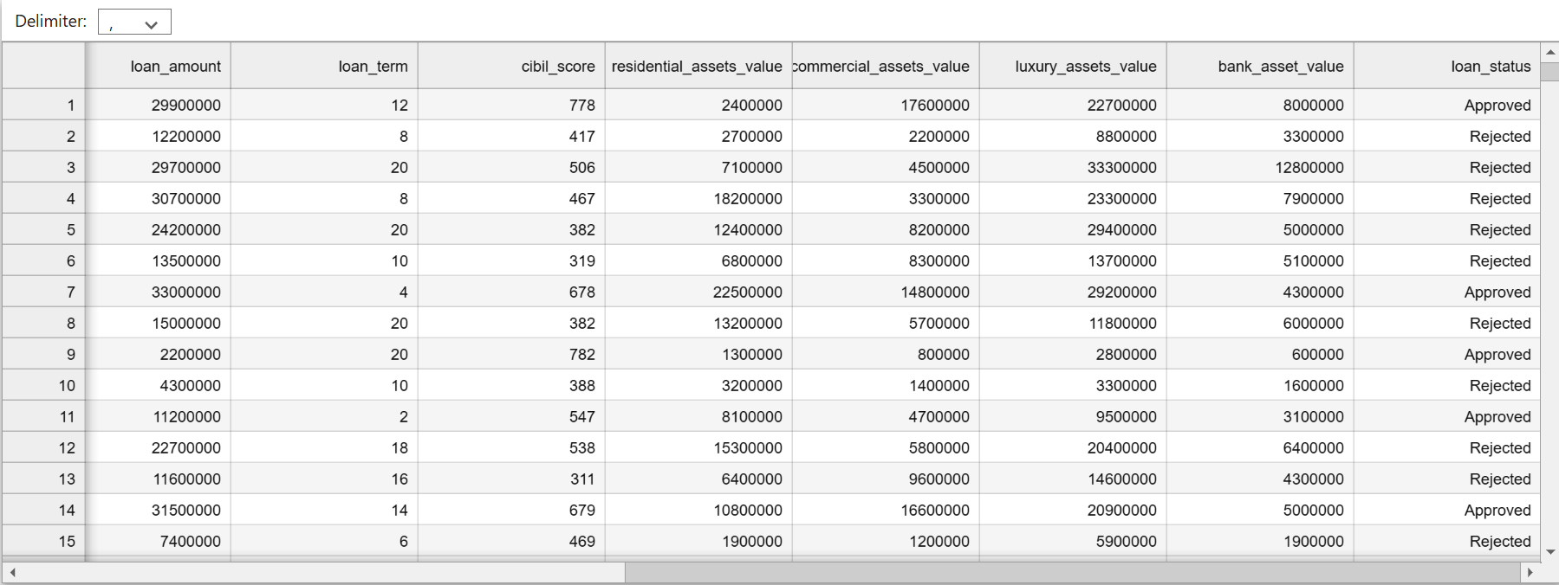
DATASET SPECIFICATIONS
The Dataset is collected from our internal workflow system for manual loan organization(Bank Loan Status dataset of Kaggle)

Slide 6
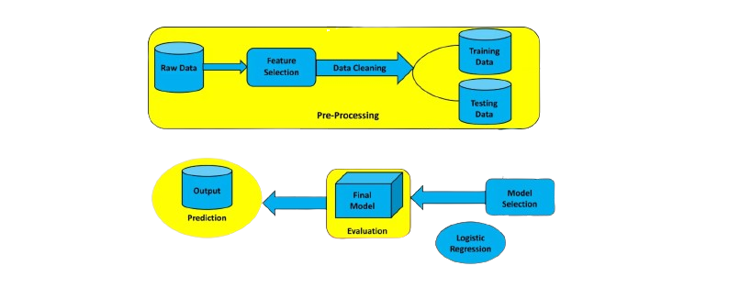
SYSTEM ARCHITECTURE

Slide 7
MACHINE LEARNING PREDICTION MODEL
Logistic regression is one of the most popular Machine Learning algorithms, which comes under the Supervised Learning technique. It is used for predicting the categorical dependent variable using a given set of independent variables.
Logistic regression predicts the output of a categorical dependent variable. Therefore, the outcome must be a categorical or discrete value. It can be either Yes or No, 0 or 1, true or False, etc. but instead of giving the exact value as 0 and 1, it gives the probabilistic values which lie between 0 and 1.

Slide 8


APPLICATIONS
Banking sectors
Co-operate sectors which provide loans to their employees
An individual who wants to know about his capability of taking a loan
Loan Apps

Slide 9
THANK YOU
Hope you like our presentation!

